Slide 1
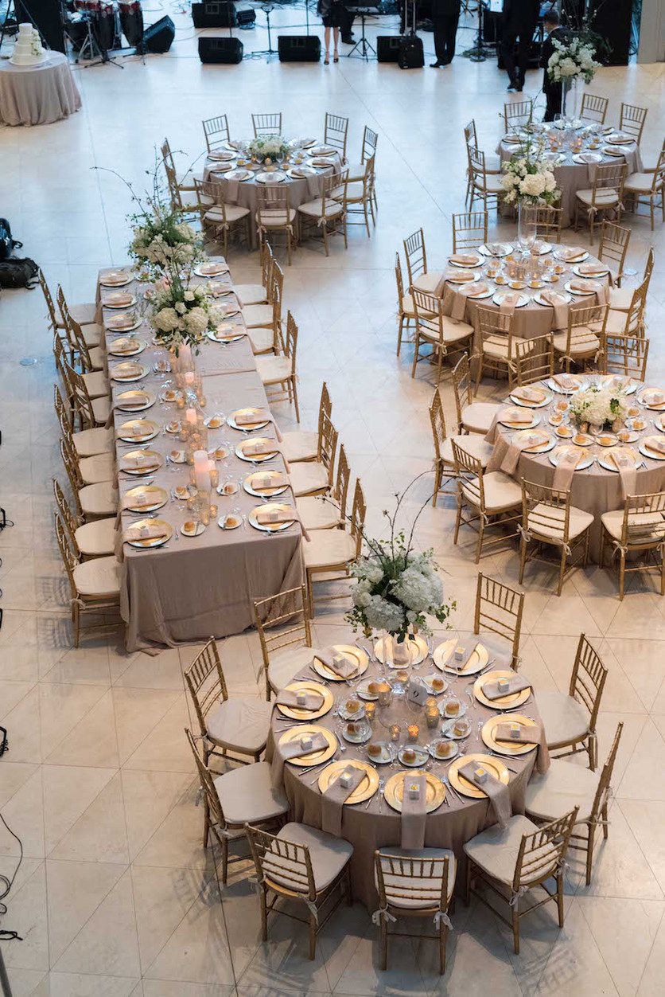
The Wedding Table

Slide 2
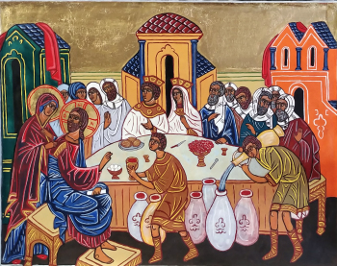
One Sabbath, when Jesus went to eat in the house of a prominent Pharisee, he was being carefully watched. There in front of him was a man suffering from abnormal swelling of his body. Jesus asked the Pharisees and experts in the law, “Is it lawful to heal on the Sabbath or not?” But they remained silent. So taking hold of the man, he healed him and sent him on his way.
Then he asked them, “If one of you has a child or an ox that falls into a well on the Sabbath day, will you not immediately pull it out?” And they had nothing to say. Luke 14: 1- 6

Slide 3
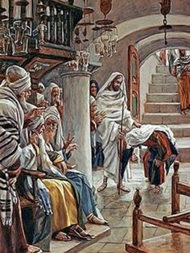
Then He asked them, “If one of you has a child or an ox that falls into a well on the Sabbath day, will you not immediately pull it out?”
And they had nothing to say. Luke 14

Slide 4
The Wedding Table

Slide 5
When he noticed how the guests picked the places of honor at the table, he told them this parable: “When someone invites you to a wedding feast, do not take the place of honor, for a person more distinguished than you may have been invited. If so, the host who invited both of you will come and say to you, ‘Give this person your seat.’ Then, humiliated, you will have to take the least important place.
But when you are invited, take the lowest place, so that when your host comes, he will say to you, ‘Friend, move up to a better place.’ Then you will be honored in the presence of all the other guests. For all those who exalt themselves will be humbled, and those who humble themselves will be exalted.”

Slide 6
Then Jesus said to his host, “When you give a luncheon or dinner, do not invite your friends, your brothers or sisters, your relatives, or your rich neighbours; if you do, they may invite you back and so you will be repaid. But when you give a banquet, invite the poor, the crippled, the lame, the blind, and you will be blessed. Although they cannot repay you, you will be repaid at the resurrection of the righteous.” Luke 14: 7 - 14

Slide 7
Where to sit?
Do you wait to be honoured?

Slide 8
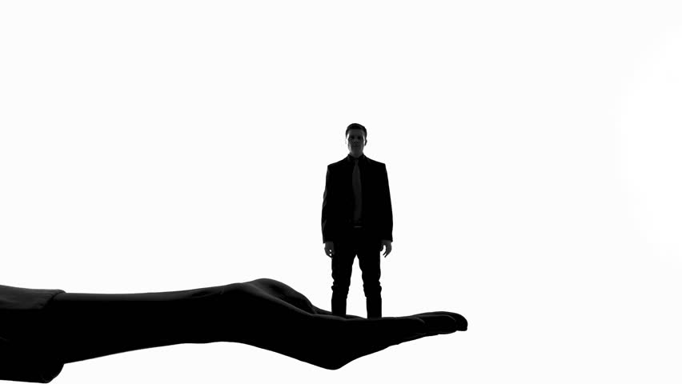
How do we see ourselves?
I have two pockets……
"I am but dust and ashes."
“The world was created
for me.”

Slide 9
Pride
Humility
is revealed by how I treat others

Slide 10
"Humility does not consist in having a worse opinion of ourselves than we deserve, or in abasing ourselves lower than we really are, but as all virtue is found in truth, so humility is founded in a true and just sense of our weakness, misery and sin. He who rightly feels and lives in this sense of his condition lives in humility." (THE VIRTUE OF HUMILITY)
“Humility is nothing else but a right judgment of ourselves.”
"We have no power of our own to move a hand or stir a foot than to move the sun or stop the clouds."
Rev. William Law

Slide 11
Here is a trustworthy saying that deserves full acceptance: Christ Jesus came into the world to save sinners—of whom I am the worst. 1 Timothy 1:15

Slide 12
Humility believes God
We are sinners
We are saved by grace
We are justified

Slide 13
Humility believes God
Humility glorifies God
A humble person relies on God
Humility values the presence of God
Humility learns from God

Slide 14
Exalted to enjoy their rights as citizens of heaven
Humility believes God
Exalted to live as members of God’s family
Humility glorifies God
Exalted to access the inheritance with Christ
Humility brings exaltation

Slide 15
“God opposes the proud but gives grace to the humble”. James 4:6

